Slide 1
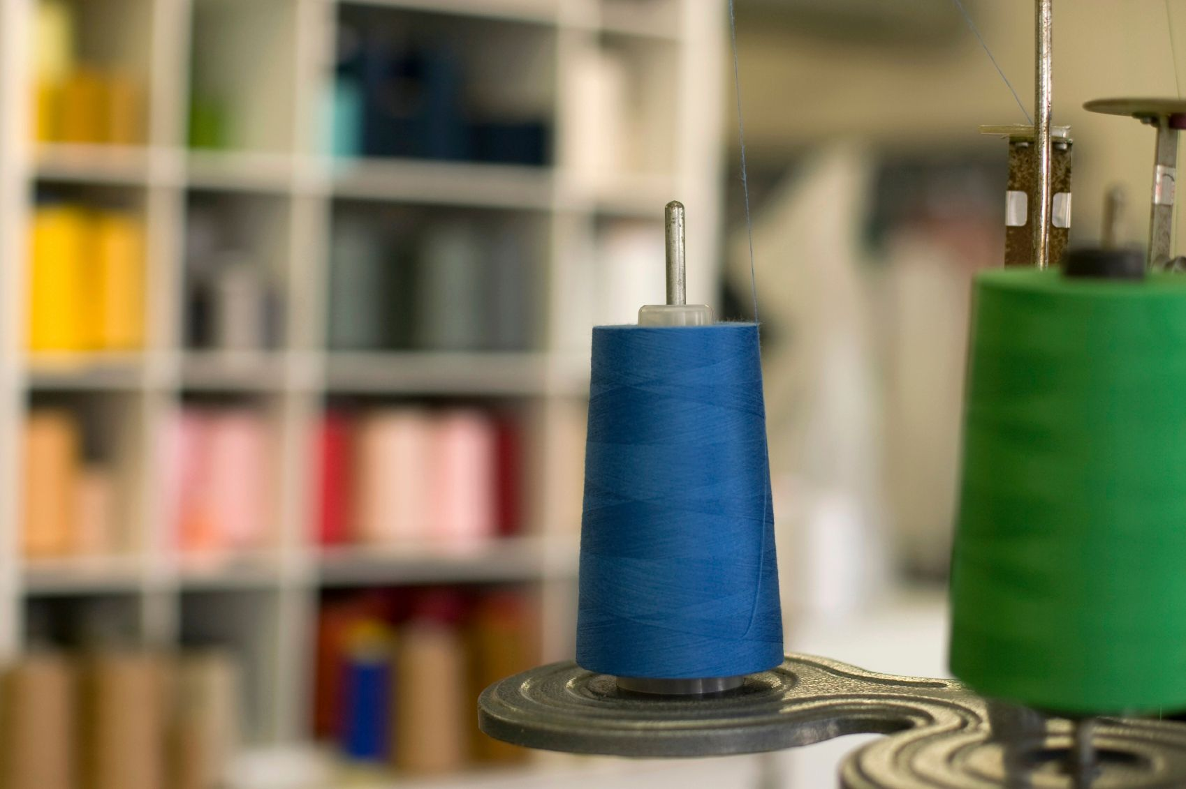
THREADS
SOFT Student Handouts,
By, Sunil Talekar, Sr. Faculty, SOFT-Pune

Slide 2
THREADS
What is a sewing thread?
Sewing threads are special kinds of yarns that are engineered and designed to pass through a sewing machine rapidly. They form efficient stitches without breaking or becoming distorted during the useful life of the product. The basic function of a thread is to deliver aesthetics and performance in stitches and seams.
Sewing thread is a flexible, small diameter yarn or strand usually treated with a surface coating, lubricant or both, intended to be used to stitch one or more pieces of material or an object to a material.

Slide 3
USE OF THREADS
Use of thread.
IN APPAREL INDUSTRY.
IN LEATHER INDUSTRY.
IN TEA INDUSTRY.
FOR FIREMAN
DEFENSE AND POLICE
HOT METAL INDUSTRY.
IN HOSPITAL FOR SURGERY
IN ARM FORCE
RAINWEAR
UPHOLSTERED FURNITURE

Slide 4
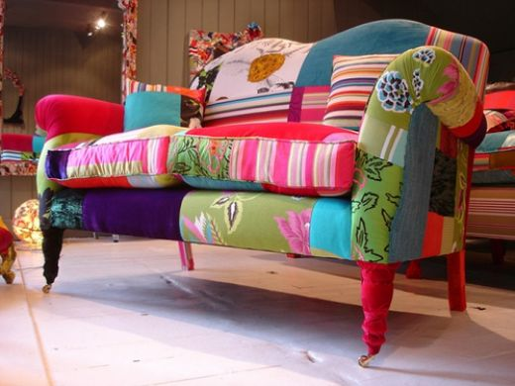
USE OF THREADS
Upholstered furniture

Slide 5
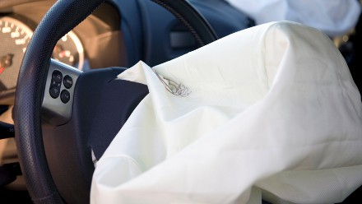

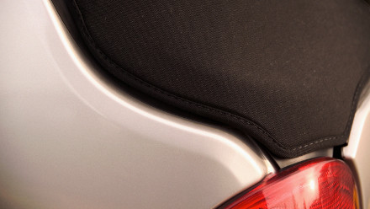
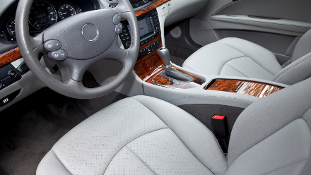
USE OF THREADS
Automotive items
Air bags
Spare wheel cover
Convertible tops
Seat covers

Slide 6
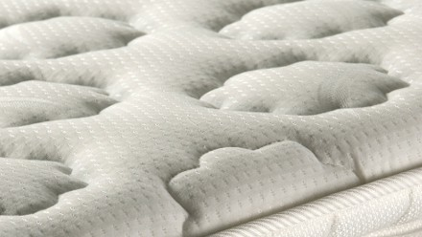
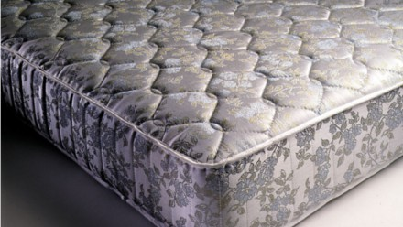
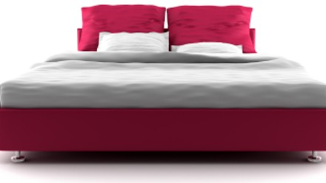
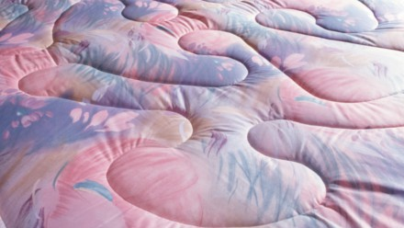
USE OF THREADS
Bedding and mattresses
Mattress topper
Mattresses
Quilting
Multi thread quilting

Slide 7

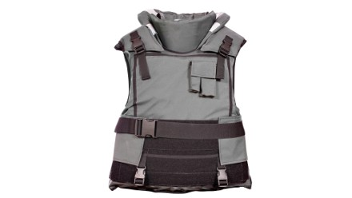

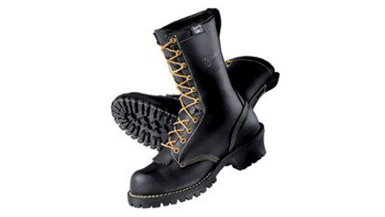
USE OF THREADS
Flame retardant and protective wear
Protective cloths
Bullet proof vest
Wetsuits
Protective shoes

Slide 8
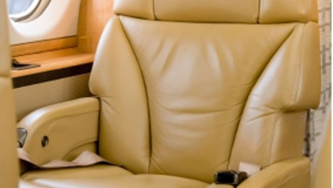
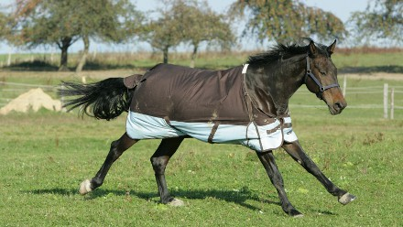
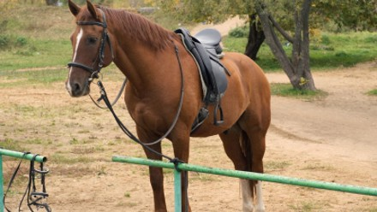

USE OF THREADS
Outdoor pursuit
Aircraft seats
Horse rugs
Saddlery
Hot air balloons

Slide 9
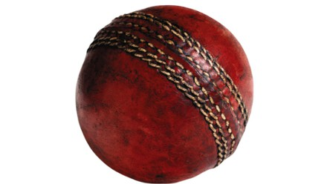

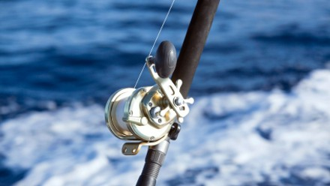
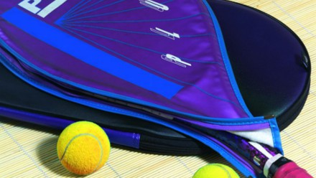
USE OF THREADS
sports equipment
Leather Ball
Hang gliders
Fishing lines
Racket cover

Slide 10
THREAD TWIST
Thread twist
Twist – The ‘twist’ of a thread refers to the number of turns per unit length required to hold the fibres / plies together to give the yarn / thread substance the required strength and flexibility. A thread with an excessive twist is also likely to give trouble while sewing due to ‘twist liveliness’, which can cause snarling, loops, knots and possible spillage that prohibit stitch formation.

Slide 11
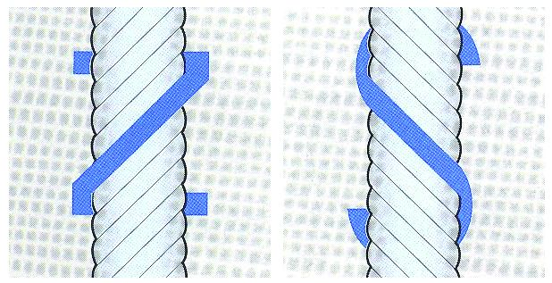
THREAD CLASSIFICATION
Thread twist
Twist direction – Direction of twist is identified as ‘S’ for left twist and ‘Z’ for right twist.
Most single needle lock stitch and other machines are designed for ‘Z’ twist threads. ‘S’ twist thread untwists during stitch formation.

Slide 12
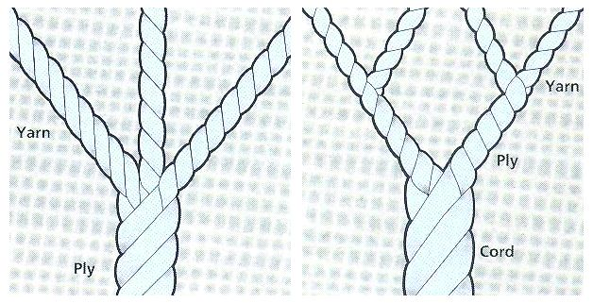
COTTON THREAD
Thread ply, cord
Ply and cord – Yarns with many components are twisted together to form ply thread. Most commonly used are 2, 3 or 4 ply threads. Threads are twisted together to give corded thread. Most commonly used are 4, 6 or 9 cord threads.
Size – The overall thickness of the final thread is referred to as ‘Grist’, ‘Ticket Number’, ‘Tex’ or ‘Count’. Thread should be as fine as possible depending on the required strength of seam.

Slide 13


COTTON THREAD
Thread ply, cord

Slide 14
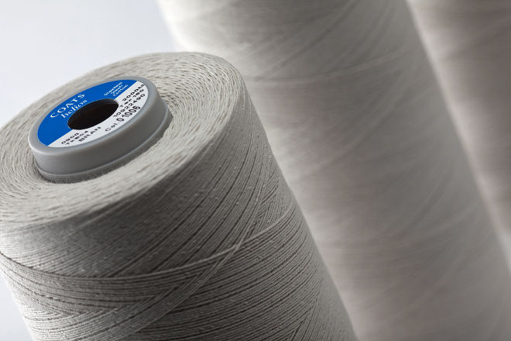
THREAD CLASSIFICATION
Thread classification
Thread can be classified in different ways. Some common classifications are those based on:
1. Substrate
2. Construction
3. Finish

Slide 15
THREAD CLASSIFICATION
THREAD CLASSIFICATION BASED ON SUBSTRATE
NATURAL
The usage of thread made from natural substrates is now minimal in industry applications. However, the most commonly used natural thread is cotton thread.
SYNTHETIC
Due to the limitations of natural fibres, thread users have turned to threads made from synthetic fibres as they have desirable properties of exceptionally high tenacity, high resistance to abrasion and good resistance to chemicals. They are also not significantly affected by moisture, rot, mildew, insects or bacteria.

Slide 16
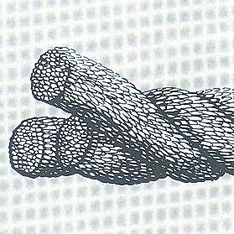
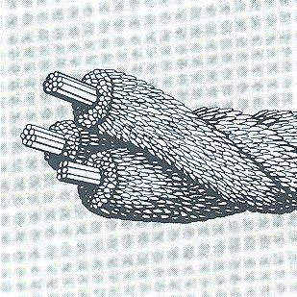
THREAD CLASSIFICATION
THREAD CLASSIFICATION BASED ON CONSTRUCTION
SPUN THREAD
is made using natural or synthetic fibers. Spun polyester is one of the most widely used threads. It is stronger than cotton threads of a comparable size, and is available in a wide variety of sizes and colours.
CORESPUN THREAD
is a combination of staple fibres and filaments. The most commonly used corespun thread has multiple-ply construction, with each ply consisting of a polyester filament core with cotton or polyester fibres wrapped around the core.

Slide 17
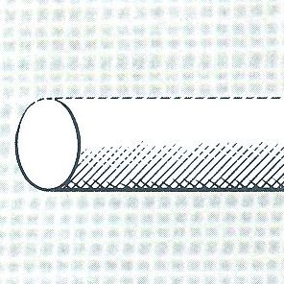
THREAD CLASSIFICATION
THREAD CLASSIFICATION BASED ON CONSTRUCTION
Filament threads are stronger than spun threads of the same fibre and size. Three types of filament threads are commonly used are;
MONOFILAMENT THREAD
SMOOTH MULTIFILAMENT THREAD
TEXTURED FILAMENT THREAD
MONOFILAMENT THREAD
is made from a single continuous fibre with a specified thickness. Though monofilament is strong, uniform and inexpensive to make, it lacks flexibility and is stiff and scratchy in feel. As a result, usage is normally restricted to hems, draperies, and upholstered furniture.

Slide 18
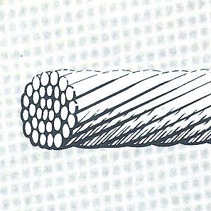
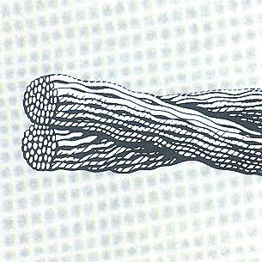
THREAD CLASSIFICATION
Thread classification based on construction
SMOOTH MULTIFILAMENT THREAD is usually made from nylon or polyester and is used where high strength is a primary requirement. It consists of two or more continuous filaments twisted together. It is commonly used to sew shoes, leather garments, and industrial products.
TEXTURED FILAMENT THREAD is usually made from polyester and is used primarily as the looper thread for cover stitches. Texturing filaments gives the yarn more cover and high extensibility, but makes the thread more subject to snagging.

Slide 19
THREAD FINISHES
Thread classification based on FINISHES
Finishes are given to a thread for two purposes
1. TO IMPROVE SEWABILITY
Some finishes involve increasing strength, abrasion resistance and lubrication of the thread.
2. TO ACHIEVE A SPECIFIC FUNCTIONAL REQUIREMENT
Some finishes include bonding, non wick, anti-fungal, fire retardant, water repellent and anti-static finishes.
MERCERIZED the thread is treated in a solution, causing the fibres to swell. This allows the dye to better penetrate the fibres and increases the lustre of the thread. It also increases the strength of the thread.
GASSED the thread is passed through a flame at high speed to reduce the fuzz.
GLAZED the thread is treated with wax or other chemicals; them polished to create a higher lustre. Although the result is a glossy, hard finish which protects the thread, the glaze does rub off and can gum up the needle and machine.

Slide 20
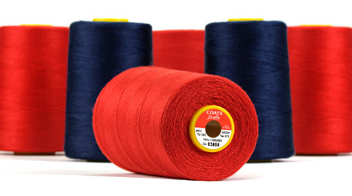
THREAD FINISHES
Thread classification based on FINISHES
WATER REPELLENT FINISH
FLAME PROOF FINISH
ANTI-BACTERIAL FINISH
ANTI-MILDEW

Slide 21
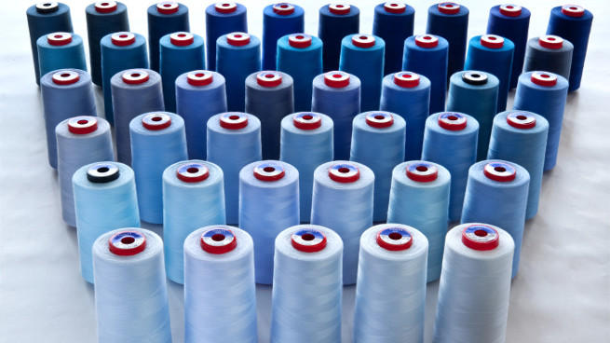
THREADS-COST BREAK UP
Fibres - It cost around 50% of the total cost
Processing - It cost around 18% - 20% of the total cost
Finishing - It cost around 20 – 25% of the total cost
Package Size - It cost around 10% – 12% of the total cost

Slide 22
THREAD CHARACTERISTIC
Factors Affecting Characteristic Of Thread
STRENGTH
SIZE; TICKET NO
PROCESSING i.e. whether it is single or how it has been winded or some special lubrication is done, etc.
PACKAGING SIZE i.e. in which thing it has been rolled depending upon the end use, i.e. cop, or spool or cone, etc. and what is the diameter of the material, as diameter increase, cost also increases as longer length of thread is required.

Slide 23
THREAD CHARACTERISTIC
Factors Affecting Characteristic Of Thread
FIBRE CONTENT, i.e. polyester, spun polyester, cotton, nylon, etc.
STRUCTURE, Corespun
TWIST; S or Z twists.
PLY; Number of filaments i.e. mono, multiple, etc.
COUNT of the thread i.e. higher the more it is finer and therefore more the cost.
COLOR, Dark, light and fashion
FINISHES; finishing i.e. how it has been finished depending upon the fibre composition and end use

Slide 24
THREAD TERMINOLOGY
GENERAL TERMINOLOGY USED IN THREAD
With a wide selection of threads to choose from, it is important to know some of the terminology associated with significant thread properties to judge the differences between different thread types.
TENSILE STRENGTH is the tension at which a thread breaks, expressed in grams or kilograms (force).
TENACITY is the relative strength obtained by dividing the tensile strength by the thickness of the structure.
LOOP STRENGTH is the load required to break a length of thread which is looped through another length of the same thread.
MINIMUM LOOP STRENGTH is the strength of the weakest loop in a series of loops (tested in a continuous length of thread).

Slide 25
THREAD TERMINOLOGY
GENERAL TERMINOLOGY USED IN THREAD
ELONGATION AT BREAK is the amount by which a thread is extended at its breaking point expressed as a percentage of its original length.
MODULUS is a term used to denote a numerical value which indicates the manner in which the textile behaves when a tensile force is applied.
ELASTICITY is a property of the thread which enables it to recover to its original length after being extended by a set amount.
SHRINKAGE is the amount by which a thread contracts under the action of washing or heating.
MOISTURE REGAIN is the weight of moisture in a fiber or thread expressed as a percentage of weight of completely dry material.

Slide 26
THREAD- SEWABILITY PARAMETERS
GENERAL SEWING PARAMETERS
The parameters that define the superior Sewability of thread are:
No breakages in high-speed sewing
Consistent stitch formation
No skipped stitches
Evenness, to prevent changes in tension during sewing
A high level of abrasion resistance
Sufficient surface smoothness, to pass easily through the machine guides

Slide 27
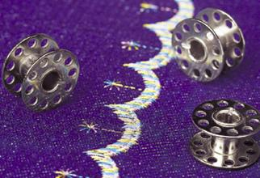
THREAD-PERFORMANCE AFFECTING FACTORS
Factors affecting performance
Thread used in garments must be durable enough to withstand the abrasion and needle heat that occur while sewing, garment finishing, stretching and recovery during wear.
Thread performance in garments can be evaluated from its
Seam strength
Abrasion resistance
Elasticity
Chemical resistance
Flammability
Colour fastness

Slide 28
QUALITIES OF GOOD THREAD
Requirements of good quality sewing thread
Good tensile strength holds the stitched seam securely during wash and wear.
Smooth surface and absence of faults ensures less friction between the needle and the material during high-speed sewing. The thread must be well lubricated to increase its Sewability and resistance to abrasion.

Slide 29
QUALITIES OF GOOD THREAD
Requirements of good quality sewing thread
Uniform thickness / diameter results in an even sewing thread, which moves smoothly and quickly through the needle eye and the fabric. It also affects the thread’s tensile strength, resistance to abrasion and its twist construction. An uneven thread may twist into short knots and jam at the eye of the needle.
Good elasticity enables thread to recover its original length immediately after the tension has been released. The elasticity of sewing thread affects the strength and the finished quality of a stitched seam.

Slide 30
QUALITIES OF GOOD THREAD
Requirements of good quality sewing thread
Good colour fastness provides immunity to the different agents the thread is exposed to during manufacture and washing. The thread must hence be uniformly dyed.
Low shrinkage of the thread being used on the fabric material with higher shrinkage reduces the chances of seam puckering.
Good resistance to chemical attack is a desirable property for thread used in garments which may undergo washing, bleaching or dry-cleaning.
Good abrasion resistance ensures a good sewing performance and makes the thread more durable.

Slide 31
SEWING THREAD TYPES
A) ON THE BASIS OF FIBER TYPES: COTTON, POLYESTER, NYLON, ETC.
B) ON THE BASIS OF THREAD CONSTRUCTION: 2PLY, 3PLY, CORE SPUN THREAD
C) ON THE BASIS OF FINISH APPLIED, MERCERIZED, GAS

Slide 32
SEWING THREAD TYPES
COTTON-Features
Made from cotton fibers. Soft in hand feel, eco friendly
Have excellent sewability because fibers are not seriously affected by the heat generated by needles during sewing.
Cotton threads are not highly durable and have a tendency to shrink when apparel is washed.
Mercerized cotton threads sew well and have lustures appearance but shrink slightly when wetted.
Easily adjusts to changes in the fabric (such as shrinkage) since it is a natural fiber
Easy care

Slide 33
SEWING THREAD TYPES
COTTON-Advantages
COTTON-Disadvantages
It gives uniformity in stitch & seam appearance
Dying is easy and easily gets the color of the fabric.
Resistance to the heat
Resistance to the tangling
Poor elasticity
Poor abrasion resistance
More expensive
Weaker (time consuming due to thread breakage)
Weakens easily by chemicals used in fabric &garment finishing
But for contrasting stitch polyester is good.

Slide 34
SEWING THREAD TYPES
Polyester-features
  Durable. Designed for heavy duty use
  Stronger, more tensile strength than rayon
  Colorfast
  Retains shape
  Recovers stretch
  Spun poly is strong, with a matte appearance
  Trilobal poly has sheen equal to rayon but is not as strong as spun poly

Slide 35
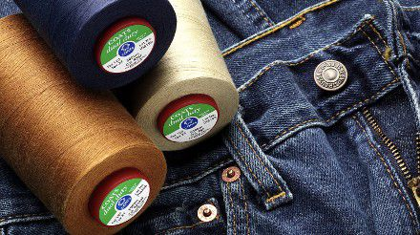
SEWING THREAD TYPES
POLYESTER

Slide 36
SEWING THREAD TYPES
POLYESTER-advantages
low cost and availability
Good strength as well elasticity, appearance and feel
absorbent property
Industrial sewing machine compatibility
Good for mass production
Good colour fastness,

Slide 37
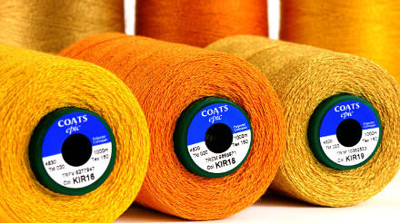
SEWING THREAD TYPES
Polyester- disadvantages
low heat resistant
Mostly need to coat with cotton fiber to give it ecofriendly feel.
Low absorbent than cotton.

Slide 38
SEWING THREAD TYPES
RAYON-Features
Characteristics of rayon
  HIGH SHEEN
  SOFT, AND WORKS WELL IN DETAIL
  RELATIVELY HEAT RESISTANT
  NOT COLORFAST
  NOT AS STRONG AS POLYESTER
  LESS DURABLE THAN POLYESTER

Slide 39
SEWING THREAD TYPES
RAYON-Advantages
LOW COST AND AVAILABILITY
  Rayon's cellulose content and method of production contribute to low cost and widespread availability. This makes rayon a popular choice for a high end visual appearance without the exorbitant costs of other threads with a similar appearance, such as silk.
APPEARANCE AND FEEL
  Sewers and manufacturers prize rayon's sheen or luster, similar to that of silk, especially for embroidery. Another bonus is that rayon thread creates a smooth and soft feeling. Because of its smoothness, rayon also lays well, creating non-bulky, easily flowing fabric.
ABSORBENT PROPERTY
  Rayon's cellulose nature enables extreme absorbency. Dyeing very absorbent material such as rayon creates brilliant colors, contributing even more to rayon thread's widespread use. Absorbency also makes rayon ideal when creating wicking fabrics for sports and hot weather applications.
SEWING MACHINE COMPATIBILITY
  Many people prefer rayon when using sewing and embroidery machines. Rayon glides through a sewing machine, not requiring drastic settings in regards to tension. Rayon thread contributes to longer lasting machines that do not break down as fast, thus lowering maintenance costs.

Slide 40
SEWING THREAD TYPES
RAYON-Disadvantages
does fade when exposed to sunlight and may also deteriorate.
When wet, rayon may stretch, but when it is washed, it may shrink.
It is also vulnerable to mildew.
Further, rayon is not very strong.

Slide 41
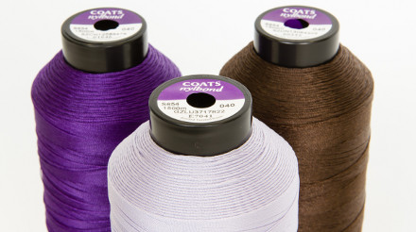
SEWING THREAD TYPES
NYLON- Features
  Strong
  Low melting temperature.
  Not heat resistant.
  Not colorfast.
  Will yellow over time.
  Becomes brittle through laundering

Slide 42
SEWING THREAD TYPES
Metallic-features
Quality metallic thread has the following components:
Nylon core. A nylon core offers the most strength. Polyester and rayon cores are inferior.
Rice paper construction. This adds strength and cohesiveness and makes the thread softer and supple, reducing the wiry feel. It also reduces tangling.
Outer coating. Lower end metallic have no outer coating. This means the metal foil rubs against the needle, creating friction, resulting in discolouring and shredding.
A good metallic has an outer coating which reduces friction and acts as a protective layer.
Laminate or Flat thread. Produced by bonding layers of polyester together and slicing to a desired width. Usually available in either 2 ply or 5 ply.
Heat resistant. can be ironed

Slide 43
SEWING THREAD TYPES
NYLON-Uses
Leather footwear
Leather goods
Furniture Upholstery (Padding)
Automotive
Luggage and travel goods
Outdoor goods and sports equipment
Protective footwear
Filtration
Computer contour stitching

Slide 44

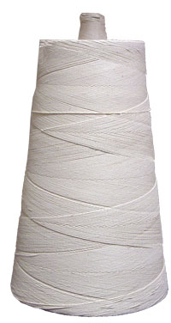
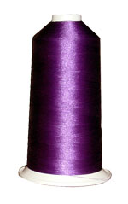
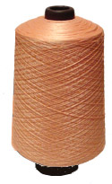
SEWING THREAD PUT-UPS
Spool
Cop
Cones
Vicone
Container
Cocoons
Prewound bobbins

Slide 45
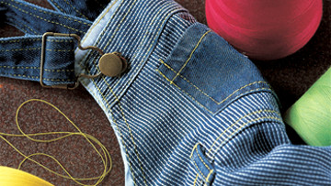
THANK YOU
Source : Coats

